Slide 1
Stacking
UIUC ECON 490 Applied Machine Learning in Economics

Slide 2

The final ensemble
Ensemble learning
Bagging
Boosting
Stacking

Slide 3
Stacking – Using model predictions as features
We have covered many models that predict in unique ways
Work well for different data sets
OLS – simple patterns loosely following a functional form
SVM – complex boundaries
Decision Trees – Thresholds
Stacking – diversity of models
Different models work well for different parts of a data set
Combining strong predictors can make a stronger predictor

Slide 4
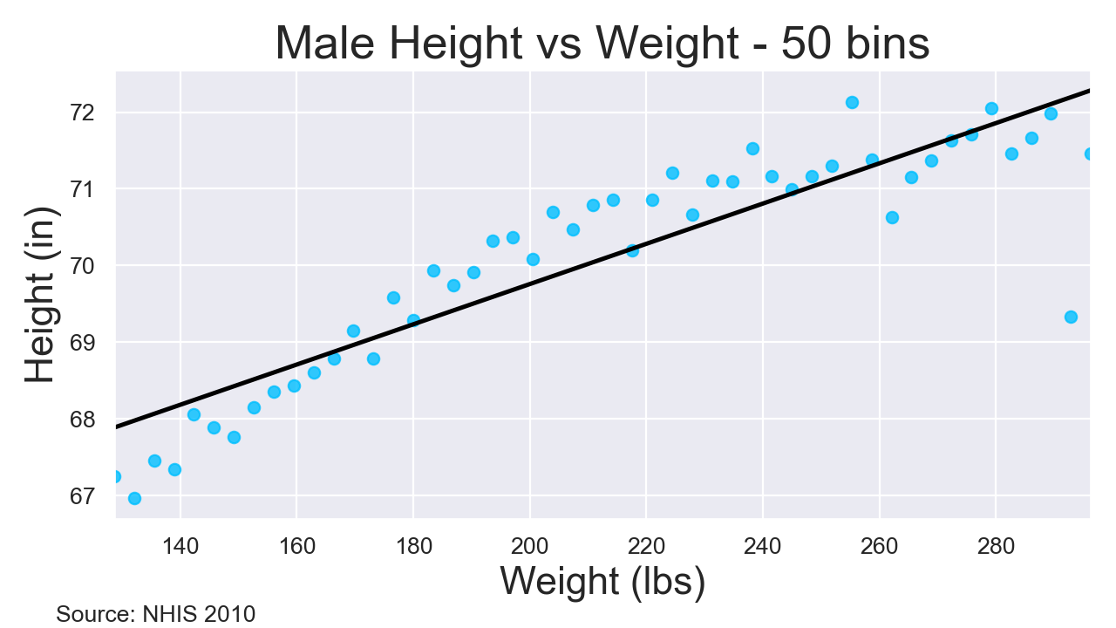
OLS: Regression – Linear in parameters

Slide 5
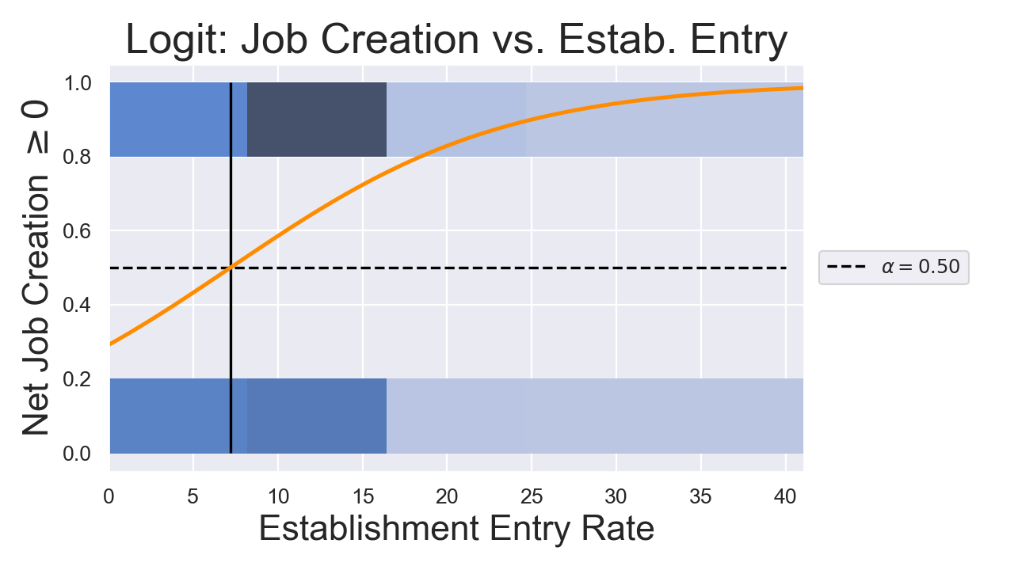
Logit: Classification – Left or right of threshold $α$

Slide 6
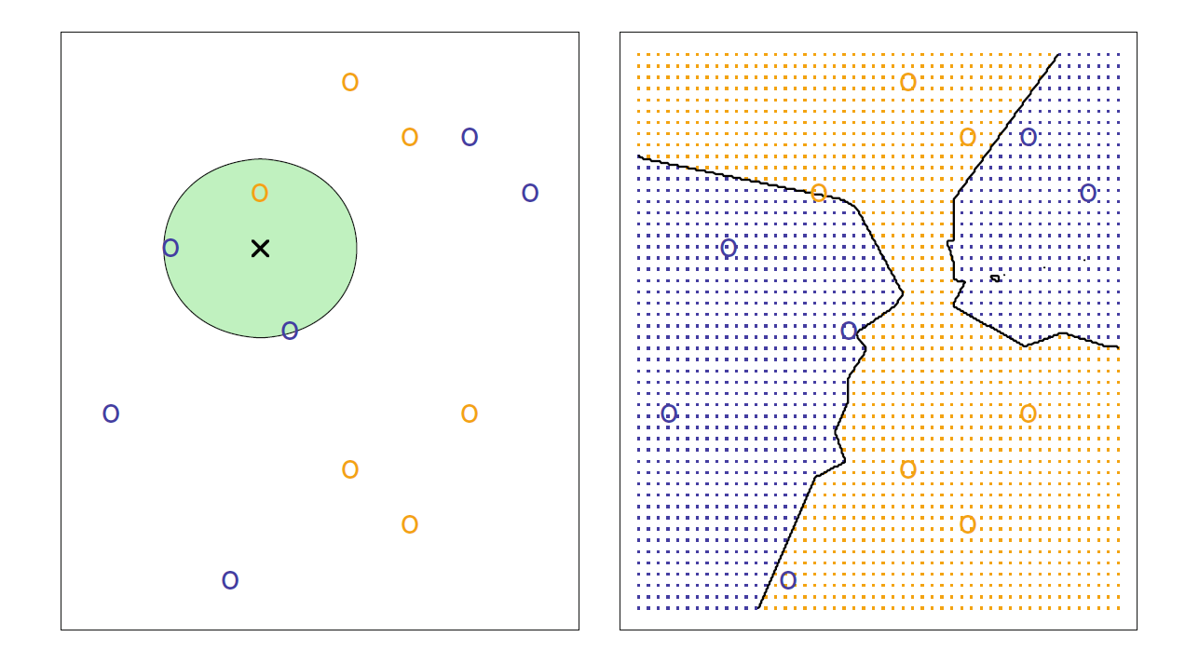
KNN: Classification or Regression – Peer pressure
Source: Introduction to Statistical Learning Figure 2.14

Slide 7
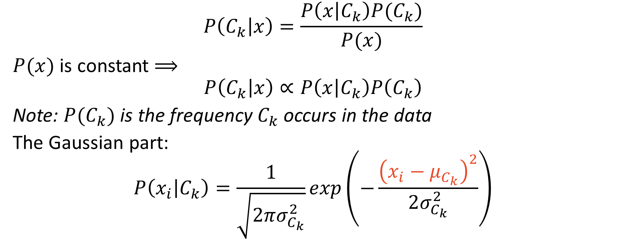
(Gaussian) Naïve Bayes: Classification – piecewise quadratics
$$P\left(C_{k} | x\right)=\frac{P\left(x | C_{k}\right)P(C_{k})}{P(x)}$$
$P(x)$ is constant $⟹$
$$P\left(C_{k} | x\right)∝P\left(x | C_{k}\right)P\left(C_{k}\right)$$
Note: $P(C_{k})$ is the frequency $C_{k}$occurs in the data
The Gaussian part:
$$P\left(x_{i} | C_{k}\right)=\frac{1}{\sqrt{2πσ_{C_{k}}^{2}}}exp\left(−\frac{{\left(x_{i}−μ_{C_{k}}\right)}^{2}}{2σ_{C_{k}}^{2}}\right)$$

Slide 8
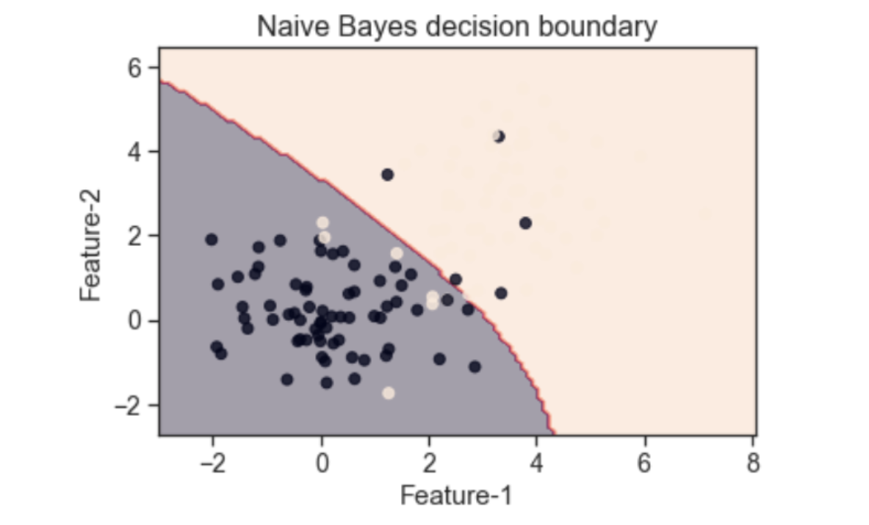
(Gaussian) Naïve Bayes: Classification
Source: https://towardsdatascience.com/easily-visualize-scikit-learn-models-decision-boundaries-dd0fb3747508
Code: https://github.com/tirthajyoti/Machine-Learning-with-Python/blob/master/Utilities/ML-Python-utils.py

Slide 9
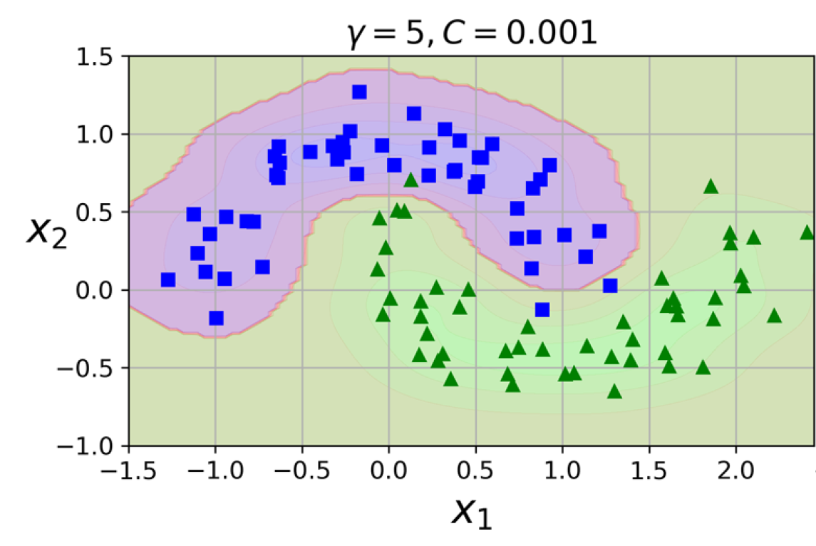
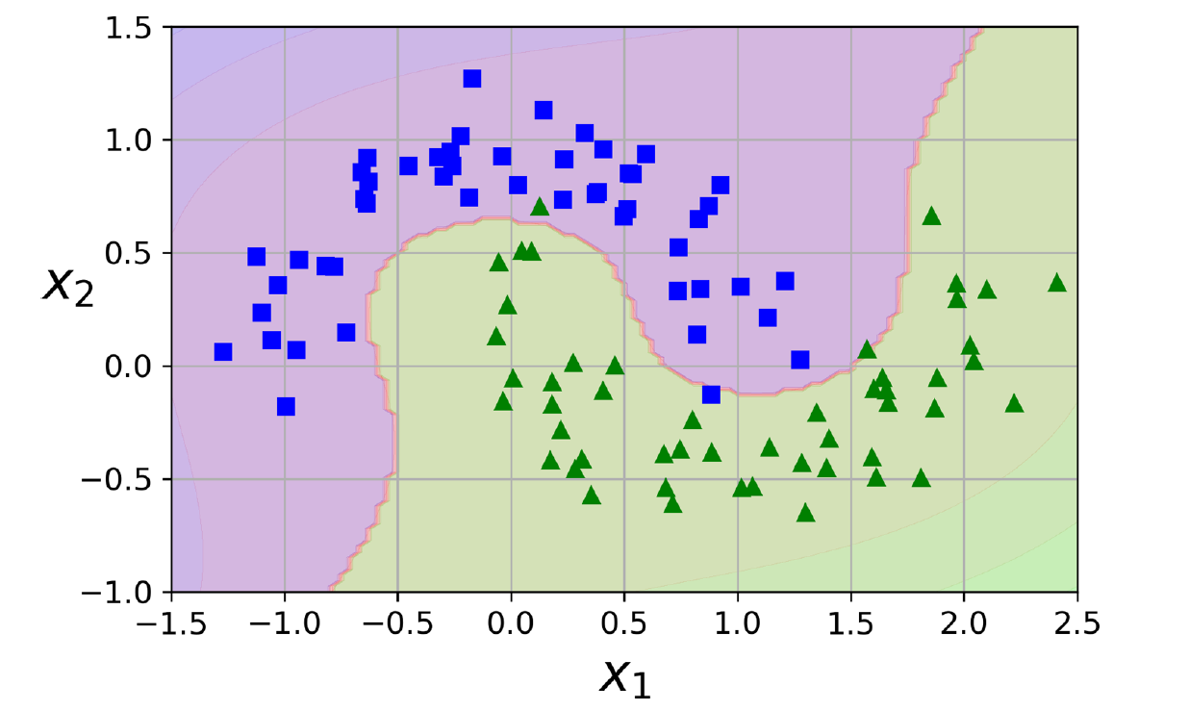
SVM: Clf or Reg – Widest street (kernel)
Polynomial
Radial basis function

Slide 10
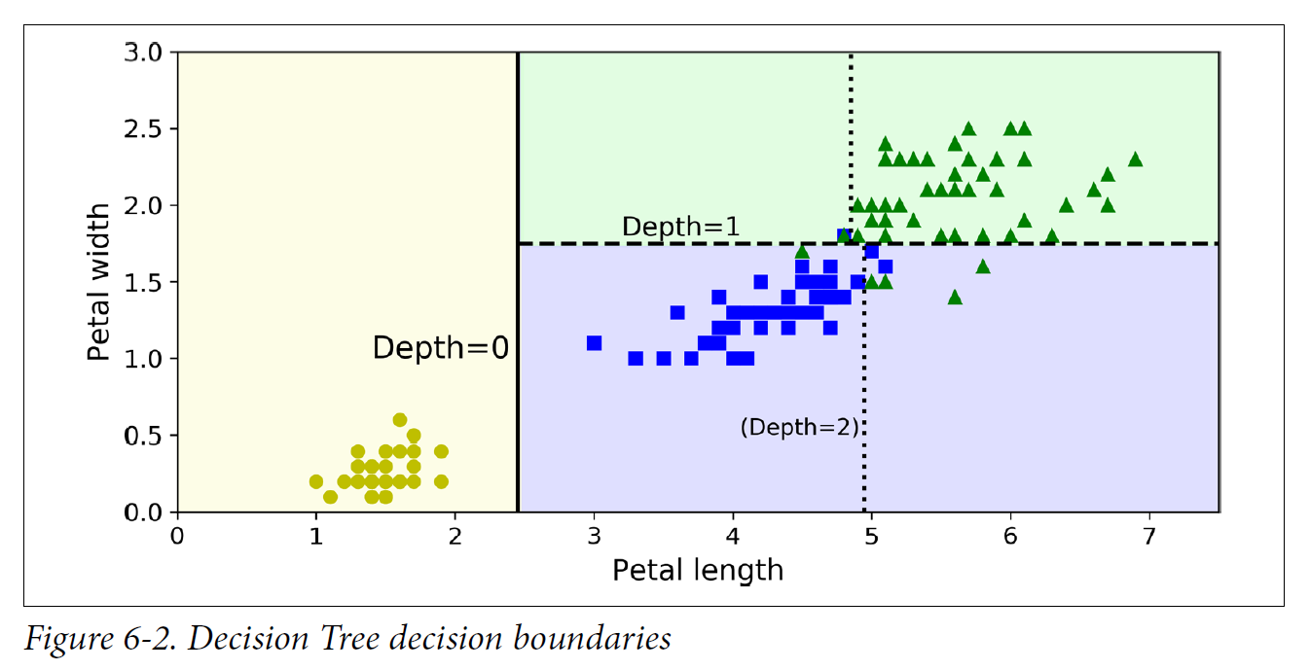
Decision Trees: Clf or Reg – Thresholds

Slide 11
Stacking
Combining Models

Slide 12
Stacking – How to
Train-test split
Split train into two: train1 and train2
Use train1 to train/tune the base learners
i.e. OLS, KNN, SVM, RF, etc.
Predict with base learners on train2. Predictions are “new features”
Use new features from train2 to train/tune stacking model
Evaluate on test

Slide 13
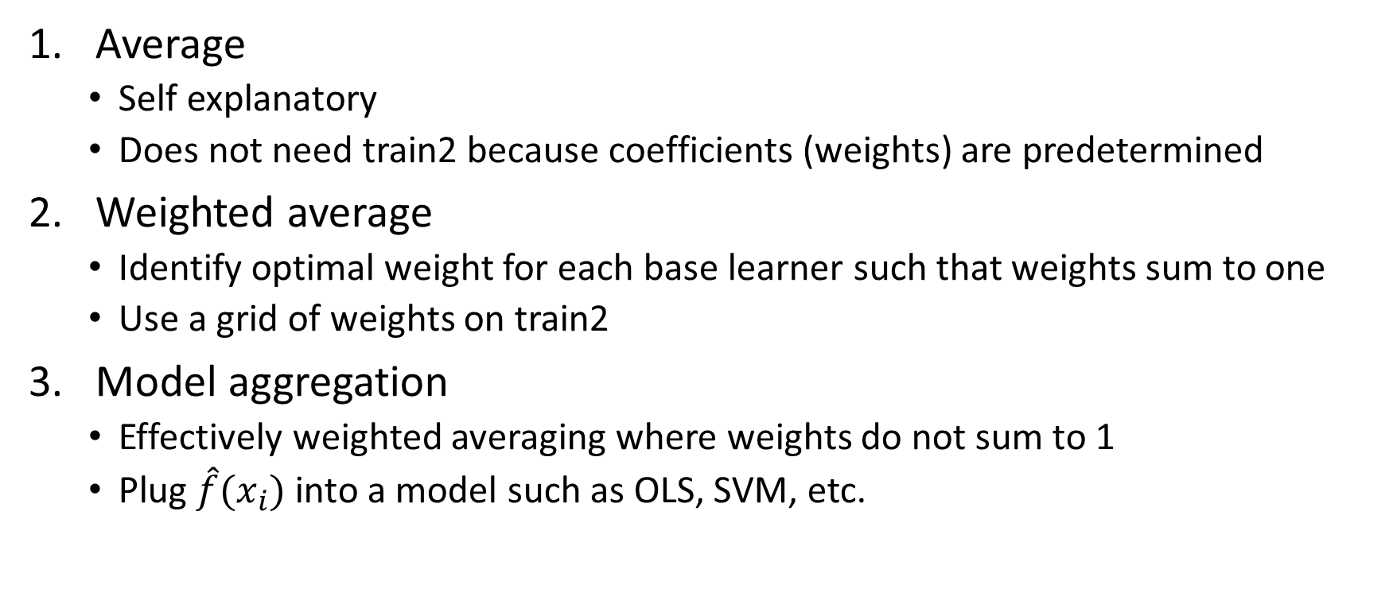
Three primary stackers
Average
Self explanatory
Does not need train2 because coefficients (weights) are predetermined
Weighted average
Identify optimal weight for each base learner such that weights sum to one
Use a grid of weights on train2
Model aggregation
Effectively weighted averaging where weights do not sum to 1
Plug $\hat{f}(x_{i})$ into a model such as OLS, SVM, etc.

Slide 14
Stacking in Classification vs. Regression
Classification
Average
Hard/soft voting
Weighted Average
soft voting only
Model aggregation
requires dummies if trained on classes
Regression
Average
Base learners get same weight
Weighted average
Grid search
Model aggregation
Plug n chug

Slide 15
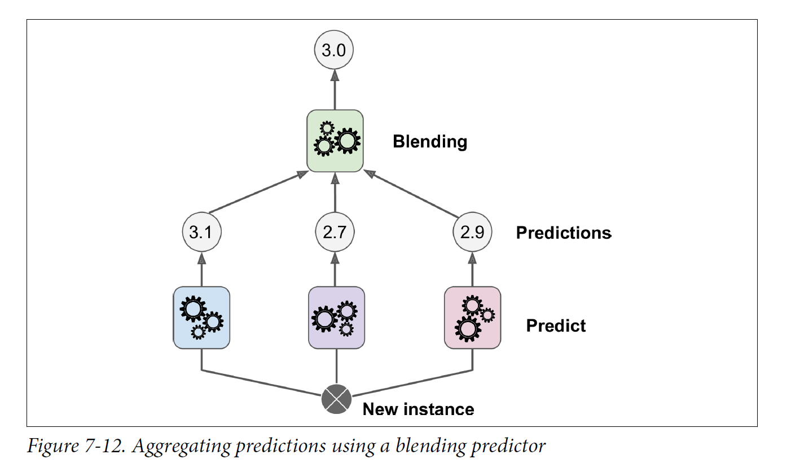
Stacking visually

Slide 16
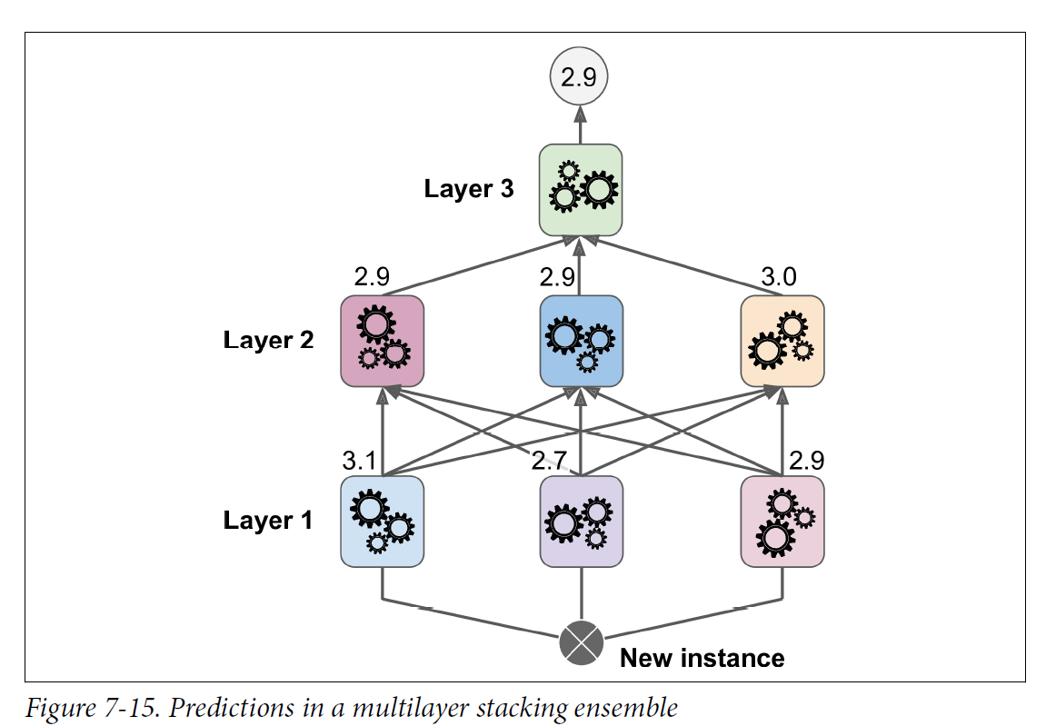
You can go deeper…
Requires splitting the training data into three parts (one per layer)
Closely related idea to neural networks

Slide 17
Main Takeaways
Stacking ensembles can improve base learner predictions with the “right” aggregator
Stacking ensembles work the best with a diversity of algorithms
Each “layer” of the ensemble needs its own training data

